Slide 1
DevOps Workshop
PRESENTED BY -
Aayush Agrawal

Slide 2








Aayush Agrawal
Education -
MS in Business Analytics, Carlson School of Management, University of Minnesota, 2017
B.Tech in Electrical Engineering, Malaviya National Institute of Technology, India, 2013
Experience –
>5 years in Data science, Currently working as a Data scientist at Land O’ Lakes, Inc.
Moderator and rank 3rd at https://www.analyticsvidhya.com/
Kaggle Expert - https://www.kaggle.com/aayushmnit
Reach me out at (@aayushmnit) –
Email - aayushmnit@gmail.com
LinkedIn - https://www.linkedin.com/in/aayushmnit/
Github - https://aayushmnit.github.io/
Medium - https://medium.com/@aayushmnit

Slide 3
Agenda
Model Building using cookbooks
Version control by GIT
Deploying models as API using Flask
Packaging applications using Docker
Deploying application in cloud

Slide 4
DevOps at a glance
DevOps-
Continuous improvement(Test and learn)
Improve the software delivery process (stakeholder management)
Reduce rework
Reduce overhead by automation
DevOps in data science -
Neat, consistent, reliable & structured code
Deploy model with API
Use containers
Use orchestration tools
Monitor all level of stacks

Slide 5

CRISP DM – Best methodology for Data science
Business Understanding
Translation of project objectives
and requirements from a business perspective to data
Science problem
Data Understanding
Data collection, quality checks, exploration,
hypothesis testing
Data preparation
Process of converting raw data to model ready data
Modeling
Building advance analytics/ machine learning model
Evaluation
Model quality assessment and results interpretation
Deployment
Automation of data and modeling pipelines
Notes:
Source – keras.io

Slide 6
Use of Cookbooks in Data science
Many of the data science task are quite repeatable and highly generalizable
60% of the time writing code is wasted on functions/program which a data scientist have already written
Reusability
Less syntax to remember
DRY (Don’t repeat yourself)
Modularity
Cleaner and well written code
Reliable performance by multiple re-use in different scenario
Faster execution
Less code to write (10Xer)
Consistent output to analyze
Customizable
Appending/Removing functionality
Customizable documentation
Notes:
Source – keras.io

Slide 7
My cookbooks overview
Link to git repo - https://github.com/aayushmnit/cookbook
Generic Preprocessing - Helper functions to do EDA, missing value analysis & treatment and generic preprocessing like (scaling, encoding etc.)
Machine learning - Classification - Helper functions to solve classification type problems in machine learning. It contains codes for holdout/cross validation, model explanation codes (LIME and variable importance plot), and codes for general classification algorithms (Xgboost, LightGBM, Extra trees, random forest, logistic regression, decision trees, K-nearest neighbors and SVM)
Machine learning - Regression - Helper functions to solve regression type problems in machine learning. It contains codes for holdout/cross validation, model explanation codes (LIME and variable importance plot), and codes for general regression algorithms (Xgboost, LightGBM, Extra trees, random forest, linear regression, regression trees, K-nearest neighbors and SVM)
Recommender systems - Helper functions to build recommender systems using Matrix factorization using LightFM package.
Natural language processing - Helper functions for NLP text processing and analysis like N-grams, word cloud, tokenization, lowercasing, punctuation/stopwords removal, stemmer/lemmatizer, TF-IDF & count vectorizer
Notes:
Source – keras.io

Slide 8
Agenda
Model Building using cookbooks
Version control by GIT
Deploying models as API using Flask
Packaging applications using Docker
Deploying application in cloud

Slide 9
Who should use Git?
Anyone wanting to track edits
Review a history log of changes made
View differences between versions
Retrieve old versions
Anyone needing to share changes with collaborators
Anyone not afraid of command line tools
https://www.linkedin.com/learning/git-essential-training/who-should-use-git

Slide 10
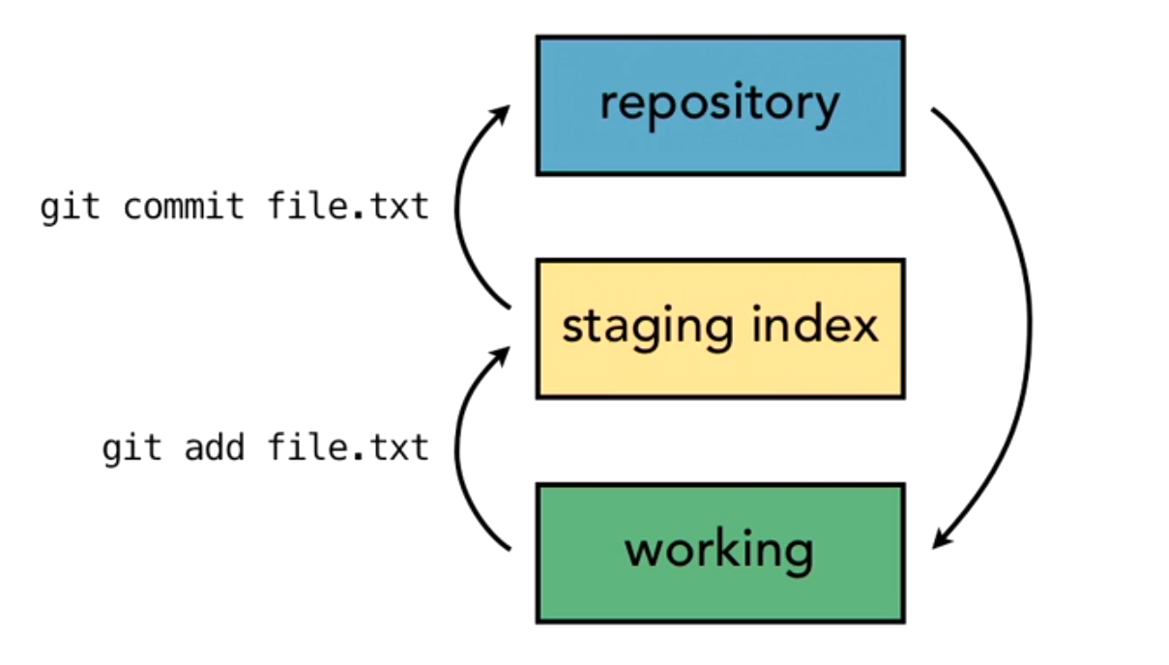
Git follows a three tree architecture
Remote(server)
https://www.linkedin.com/learning/git-essential-training/exploring-the-three-trees-architecture

Slide 11
Useful Links
Git essentials training - https://www.linkedin.com/learning/git-essential-training
Git cheat sheet

Slide 12
Agenda
Model Building using cookbooks
Version control by GIT
Deploying models as API using Flask
Packaging applications using Docker
Deploying application in cloud

Slide 13



Flask is a micro service web platform framework
Many machine learning models are used real time at the heart of any data product.
Options to implement Machine Learning models –
Option 1: Rewriting the whole code in the same language as product
Very hard and time consuming process
Option 2: API-first approach
Web APIs have made it easy for cross-language applications to work well
Software product can just call the API with bunch of parameters to get result regardless of backend language
Notes:
Source - http://llcao.net/cu-deeplearning17/lecture/keras_presentation.pdf

Slide 14
Agenda
Model Building using cookbooks
Version control by GIT
Deploying models as API using Flask
Packaging applications using Docker
Deploying application in cloud

Slide 15

Docker is a containerization platform
Docker is a platform for developers and sysadmins to develop, deploy, and run applications with containers.
Containerization is increasingly popular because containers are:
Flexible: Even the most complex applications can be containerized.
Lightweight: Containers leverage and share the host kernel.
Interchangeable: You can deploy updates and upgrades on-the-fly.
Portable: You can build locally, deploy to the cloud, and run anywhere.
Scalable: You can increase and automatically distribute container replicas.
Stackable: You can stack services vertically and on-the-fly.
Image - An image is an executable package that includes everything needed to run an application--the code, a runtime, libraries, environment variables, and configuration files
Container - A container is a runtime instance of an image--what the image becomes in memory when executed
Notes:
Source - https://www.cs.toronto.edu/~frossard/post/vgg16/

Slide 16
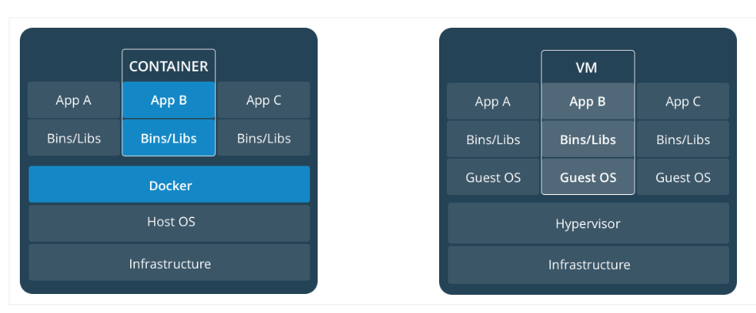
Container is light weight because it doesn’t require an OS
Notes:
Source - https://www.cs.toronto.edu/~frossard/post/vgg16/

Slide 17
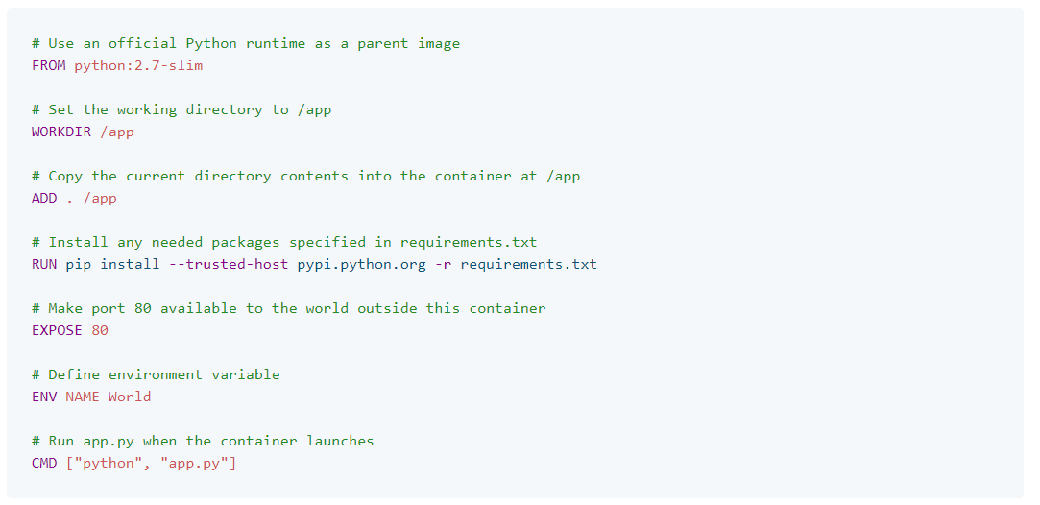
Creating your own docker file
https://docs.docker.com/get-started/part2/#dockerfile
Notes:
Source - https://www.cs.toronto.edu/~frossard/post/vgg16/

Slide 18
Basic Docker commands
Basic commands -
List docker images: “docker images”
To run a docker image: “docker run --<option> <image_name>
Delete a docker image: “docker rmi <image ID>”
List all the containers :“docker container ls -la”
Stop container from running: “docker container stop <container ID>”
Stop container from running: “docker rm <container ID>”
To build a docker image –
cd to the folder DOCKERFILE
Run the command “docker build -t <image_name>”
To push an image to DockerHub -
Create a repo on docker hub
Login using DockerHub credentials: “docker login --username=<user_id>“
Run command “docker tag <image_id> <user_name>/<repo_name>:<tag>”
Run command “docker push <user_name>/<repo_name>”
Notes:
Source - https://www.cs.toronto.edu/~frossard/post/vgg16/

Slide 19
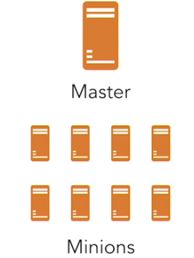
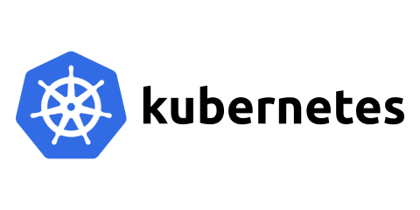
Scaling with Kubernetes
Kubernetes is an open-source system for automating deployment, scaling, and management of containerized applications.
Kubernetes can perform simple task –
Starting and stopping containers
Determine where to run containers
Checking health of containers
Restarting or replacing unhealthy containers
Master node runs -
Kube-apiserver
Etcd(Key-value) for cluster data
Kube-scheduler for deciding where to run a container
Kube-controller-manager controls replication processes and endpoints
Cloud controller manager which interacts with cloud services
Minion node runs –
Kublet – to make sure containers run inside a pod
Kube-proxy – to manage network operations
Container-runtime – manages execution of containers
Notes:
Source - https://www.cs.toronto.edu/~frossard/post/vgg16/

Slide 20
Some good resources on topic discussed
Git essential training- Lynda
Docker –
Docker official tutorial – Link
How Docker Can Help You Become A More Effective Data Scientist – Hamel Husain
A Step Towards Reproducible Data Science : Docker for Data Science Workflows – Analytics Vidhya
API using FLASK –
Tutorial to deploy Machine Learning models in Production as APIs (using Flask) – Analytics Vidhya
How to Deploy Keras Models to Production – Siraj Raval
Flask Tutorial – Link
Deployment -
Deployment using Flask, docker and Kubernetes – Medium
Deploy Your First Deep Learning Model On Kubernetes With Python, Keras, Flask, and Docker - Medium
Deployable machine learning for data science – Lynda
Notes:
Source - https://www.cs.toronto.edu/~frossard/post/vgg16/

Slide 21
Thank You!

